Slide 1
Tertiary Supports: Self Management

Slide 2
How do we get unstuck?
Teaching Independence and Self Management
Shift behavior management responsibility from teacher to student
Self management training is a pivotal skill

Slide 3
Self Management
Discriminate between appropriate and inappropriate behavior
Reinforce own behavior
Evaluate and monitor own behavior

Slide 4
Alex:
Getting Ready to Go Home
Put my chair on the desk __
2. Get my coat ___
3. Get my backpack __
_
4. Line up ___
  I did it!!! Mon Tue Wed Thur Fri

Slide 5
 | Academic | Social | Adaptive | Play/Leisure
Profile A | Follow a work schedule independently (a minimum of 2 tasks) | Follow a visual cue to ask for a break up to 3 times per 15 minute activity | Complete handwashing routine independently | Follow a play schedule independently (a minimum of 2 tasks)
Profile B | Follow a work schedule independently ( a minimum of 4 tasks) | Follow a visual cue to identify and use calming strategies | Follow visual cue to hold scissors and cut | Follow a leisure schedule independently (a minimum of 2 tasks)
Profile C | Independently complete work activity/task within a specified time frame and with 2 or less adult prompts | Follow a visual cue to take turns during a game with peers | Follow a visual cue to identify and use calming strategies | Follow visual cue to initiate and engage in social activity with peer
Profile D | Independently complete work activity/task within a specified time frame and with 1 or less adult prompts | Follow a visual cue to initiate and maintain conversations with adults and peers | Follow a visual cue to attend to whole group discussion/lesson | Follow a schedule to independently engage in a rotation of highly preferred and less preferred activities

Slide 6
Instructional Strategies
Self-Directed Learning Strategies
Antecedent cue regulation
Self-monitoring
Self-evaluation
Self-reinforcement
Self-Instruction

Slide 7
Instructional Strategies: Antecedent Cue Regulation
The use of visual or auditory prompts to assist a student in performing a target behavior
Seldom used in isolation when teaching self management (i.e. modeling, reinforcement may be needed)

Slide 10
Video Example: Auditory
..\My Documents\My Videos\Independence videos\Discrete Trial Brian R Home Program Wash Hands with Tape.mpg

Slide 11
In groups
List the examples of antecedent-cue regulation that you use?
BE CREATIVE!

Slide 12
Instructional Strategies: Self-monitoring
Involves a student observing whether or not they have performed the target behavior
1. Put my chair on my desk _____

Slide 13
Listening to my Teachers
My body and face are turned toward teacher
I am not talking when the teacher is talking
I am not fidgeting with clothes or drawing

Slide 14
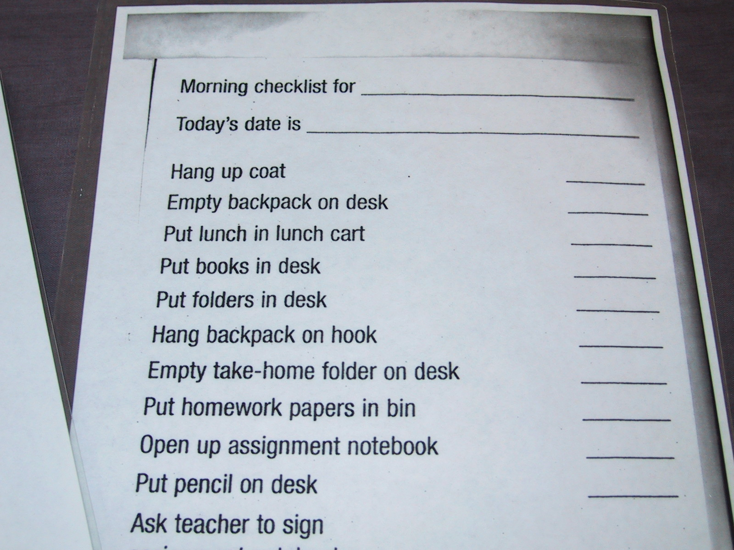

Slide 15
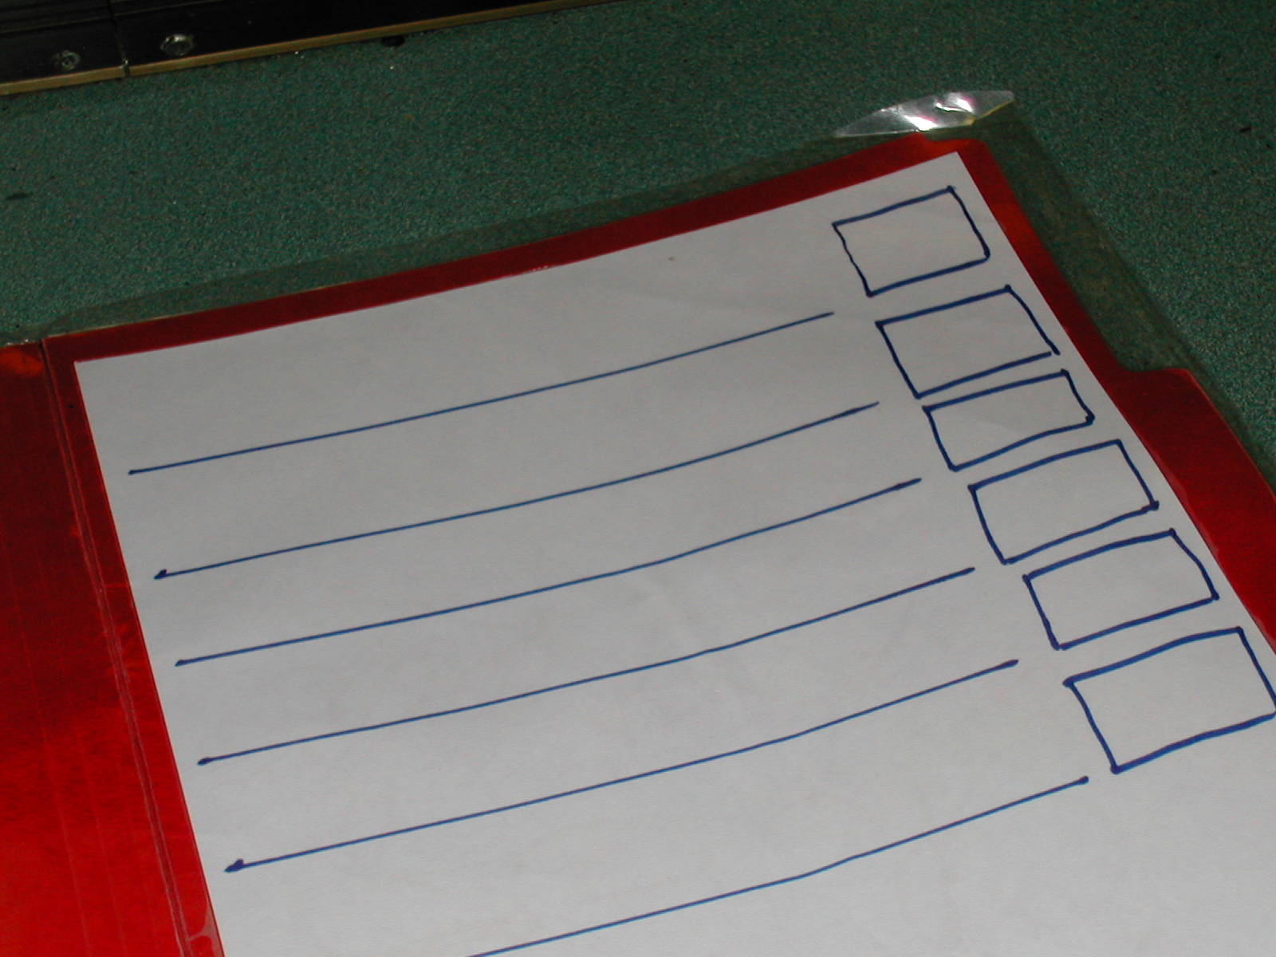

Slide 16
In groups
List different examples of self-monitoring that you experience in your world

Slide 17
Instructional Strategies: Self-instruction
Involves a student providing instruction (usually verbal) around the steps to perform a task of solve a problem
Arms straight
Knees bent
Pull back

Slide 18
Identify a problem
Evaluate the action
Deliver reinforcement
State the solution

Slide 19
Does I come before e in _______?
“I before e except after c or sounded in eigh as neighbor and weigh.”
Word is spelled correctly

Slide 20
Instructional Strategies:
Self-Evaluation
Requires a student to compare their performance of a target behavior with a set of criteria
Alex needs to complete 4 steps and marks them off

Slide 21
Mr. Franks is talking.
He is talking about:_______________
Three words I need to listen for are:
1.
2.
3.

Slide 23
In Groups
Come up with 4 examples in which you have used or seen “Self-Evaluation”

Slide 24
Instructional Strategies:
Self-reinforcement
Student accesses their own rewards or consequences
I did it!!!
Mon Tue Wed Thur

Slide 25
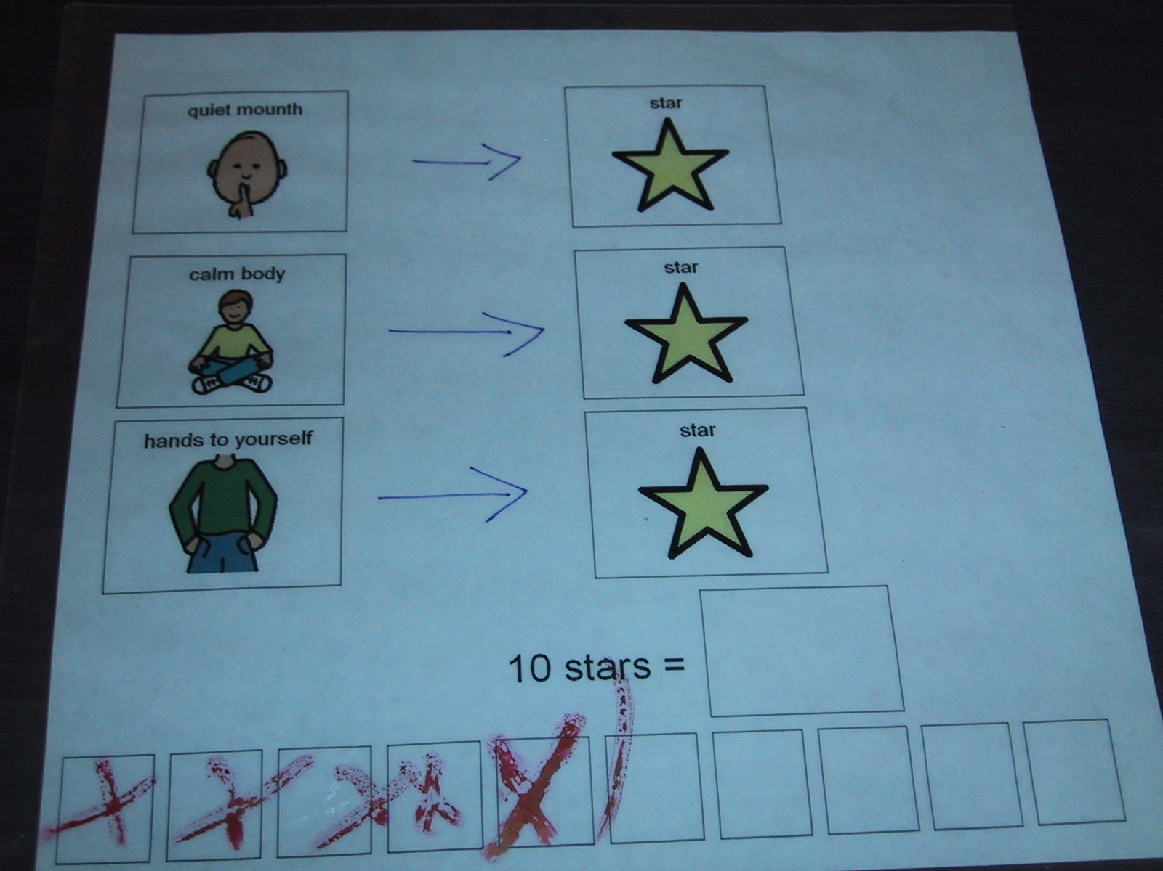

Slide 26
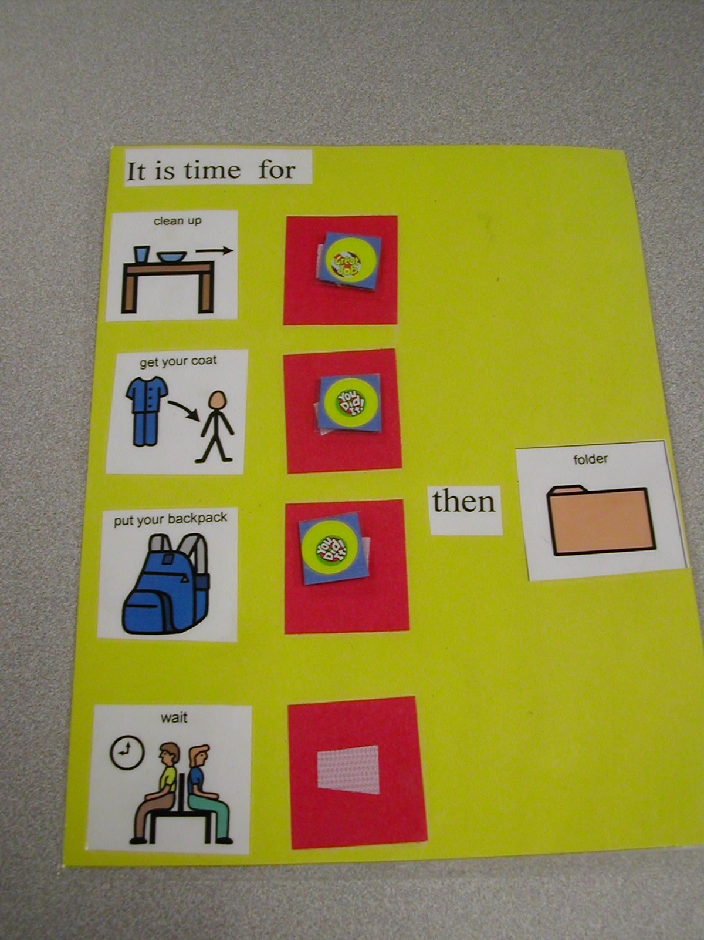

Slide 27
What
What skill are you teaching?
How
How will you teach it?
Know
How will you know when it has been learned?

Slide 28
The How is important:
Prompt Schedule
What level does the student need to get the answer right?
What is your hierarchy to fade the prompt (full physical, gesture, natural cue)
Decision rule needed (i.e. 3 prompts at each level)

Slide 29
Time For Folder Work:
1. Get Pencil
2. Get Folder
3. Open Folder
4. Take out worksheets
5. Rip off Page 1
6. Complete Page 1
7. Put in Folder
8. Complete Page 2
9. Put in Folder
10. Put Folder away

Slide 30
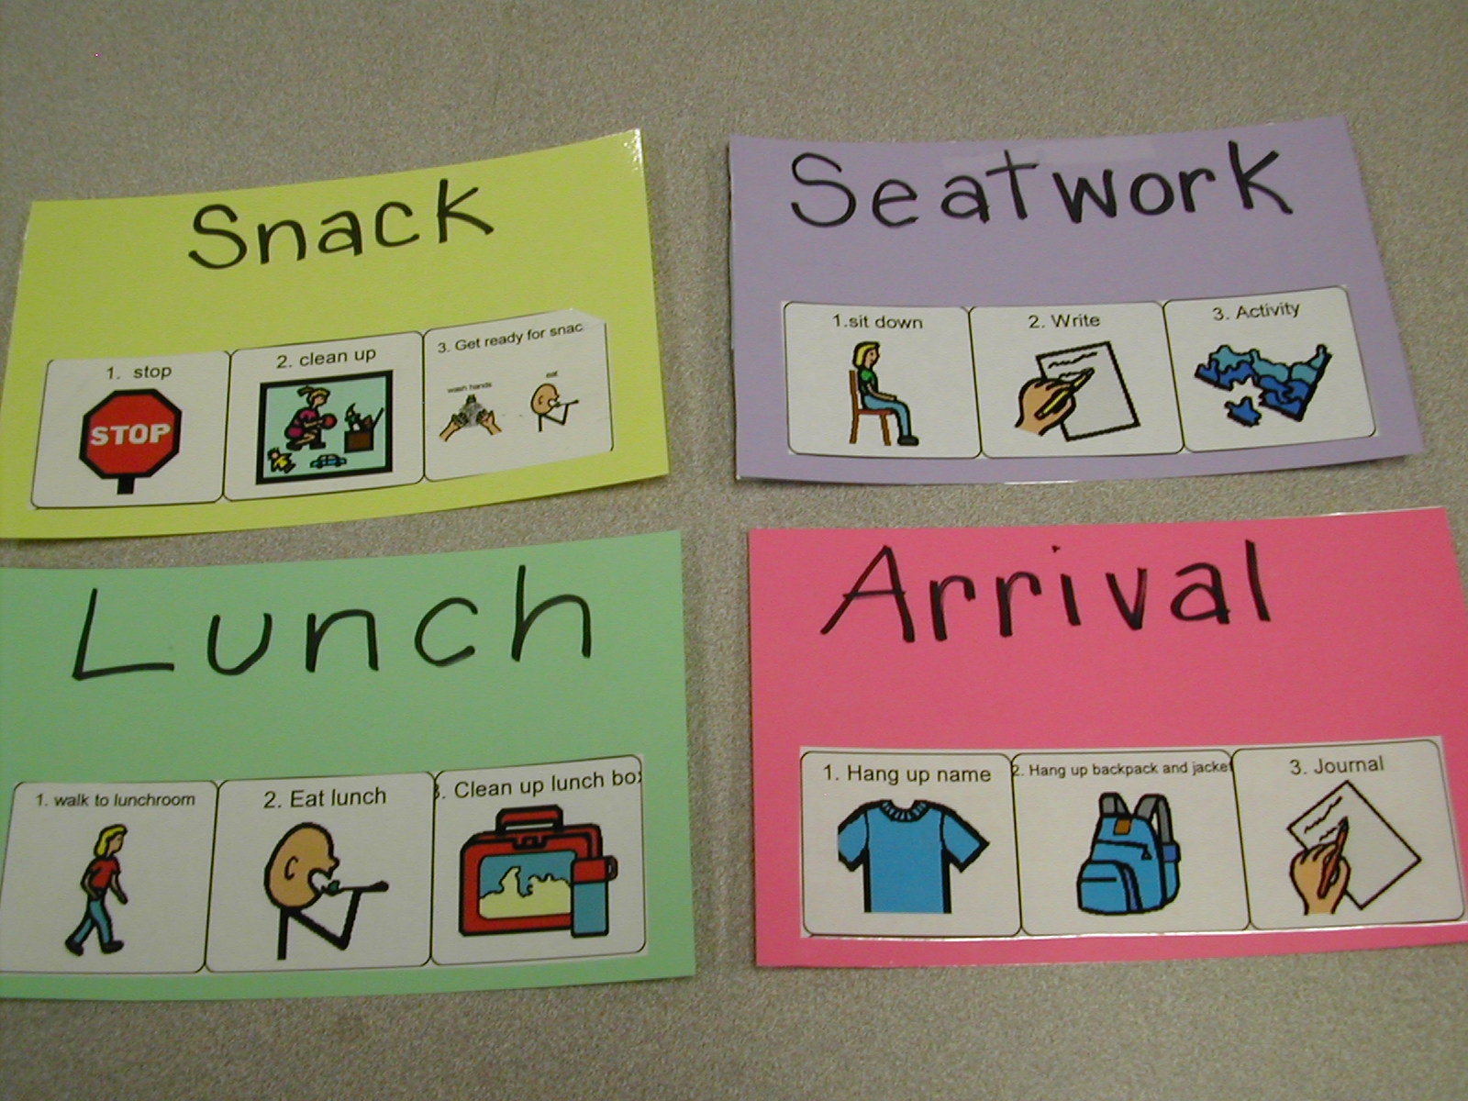

Slide 31
